Slide 1



SALES ANALYSIS

Slide 2


OBJECTIVE
To improve customer experience by analyzing the sales data and increase the company revenue

Slide 3

Imported Libraries:
Imported numpy, pandas, matplotlib, and seaborn for data analysis and visualization.
Uploaded the CSV File:
Loaded the CSV file into a pandas DataFrame.
Analyzed the Information:
Performed an initial analysis of the dataset, including checking its shape, data types, missing values, summary statistics, and visualizations to understand the data better.

Slide 4


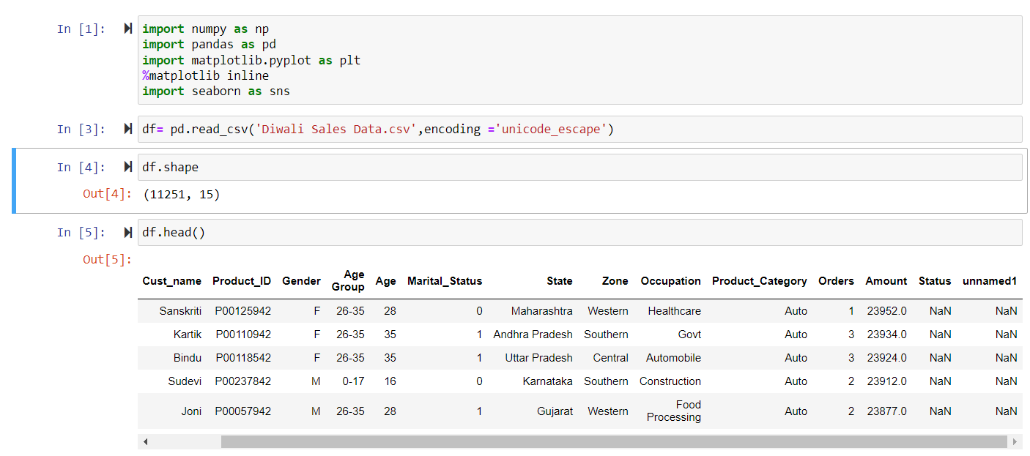
IMPORTING THE LIBRARIES

Slide 5


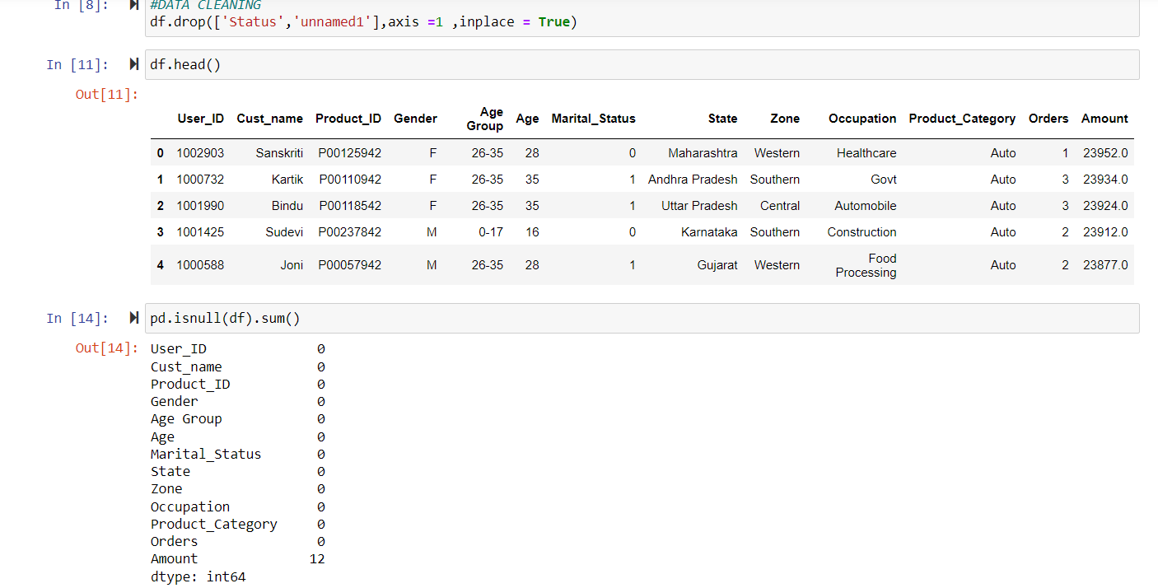

DATA CLEANING

Slide 6

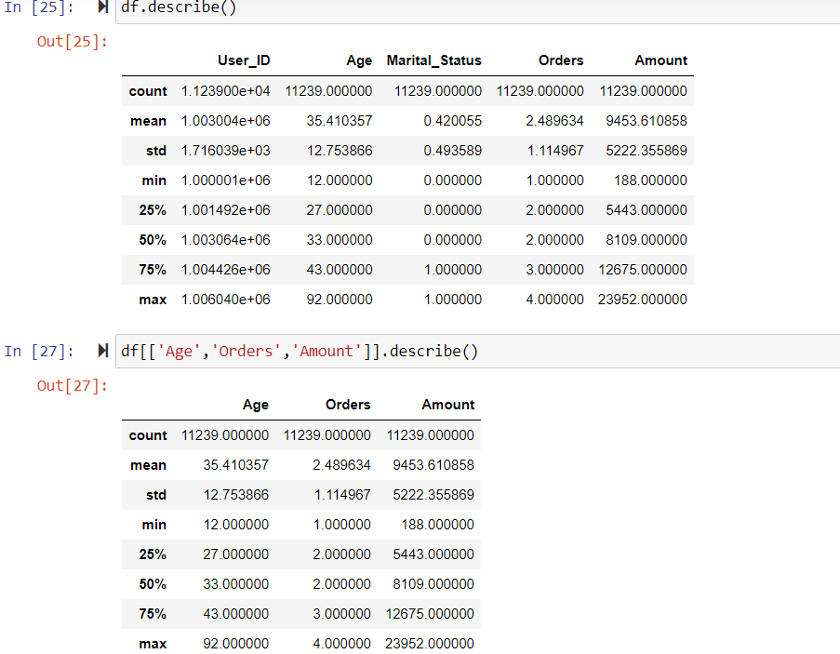

To provide a detailed description of the dataset, we will compute the following statistical measures for each numerical column:
*Count
*Mean
*Standard Deviation
*Minimum Value
*Maximum Value
*Percentiles (25th, 50th, and 75th)
INSIGHTS
The dataset contains information about 11,239 orders.
Here is a detailed summary of key statistics:
Buyer Age
Minimum Age: 12-13 years
Maximum Age: 92 years
Number of Items Purchased
Minimum Items Purchased: 1 item
Maximum Items Purchased: 4 items
Amount Spent on Items
Minimum Amount Spent: Rs 188
Maximum Amount Spent: Rs 23,952

Slide 7
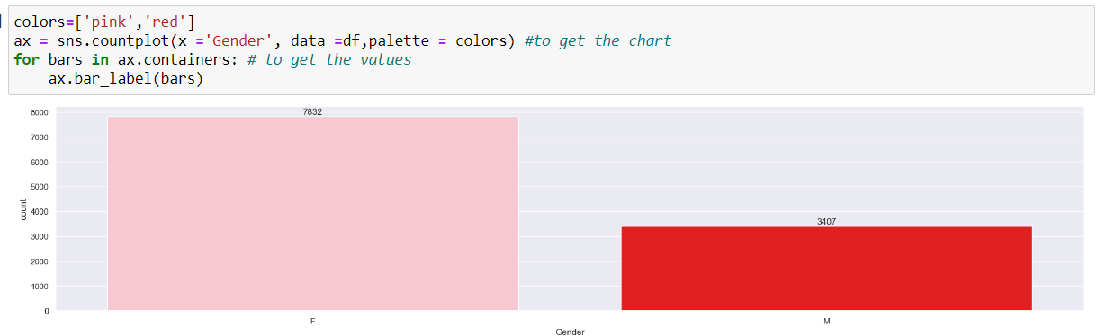
EXPLORATORY DATA ANALYSIS
ON THE BASIS OF GENDER
Female Count:7832
Male Count:3407

Slide 8
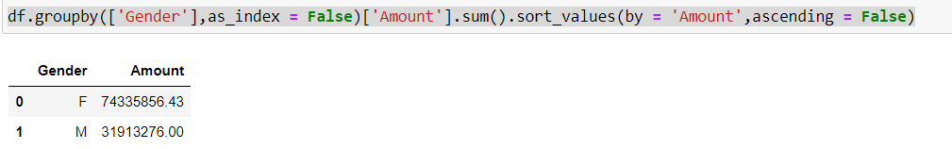
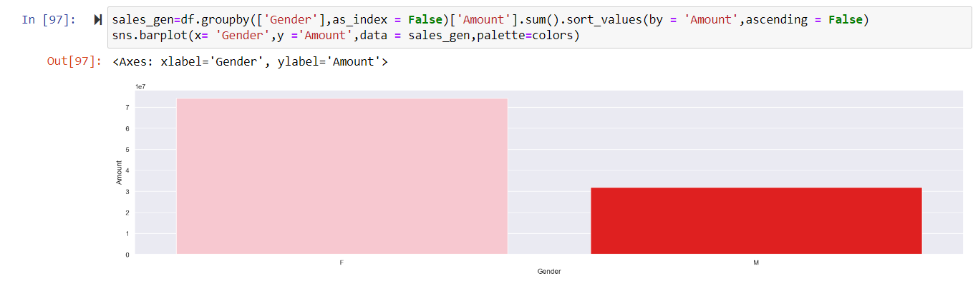
From the above graphs we can see that most of the buyers are females and even the purchasing power of females are greater than the men

Slide 9
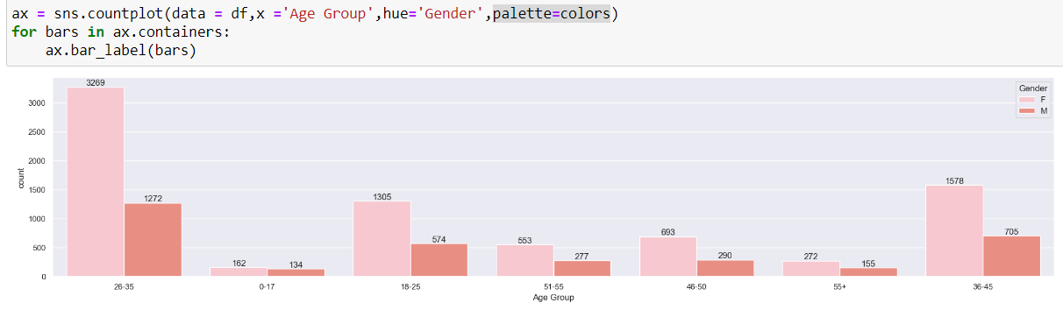
ON THE BASIS OF AGE

Slide 10
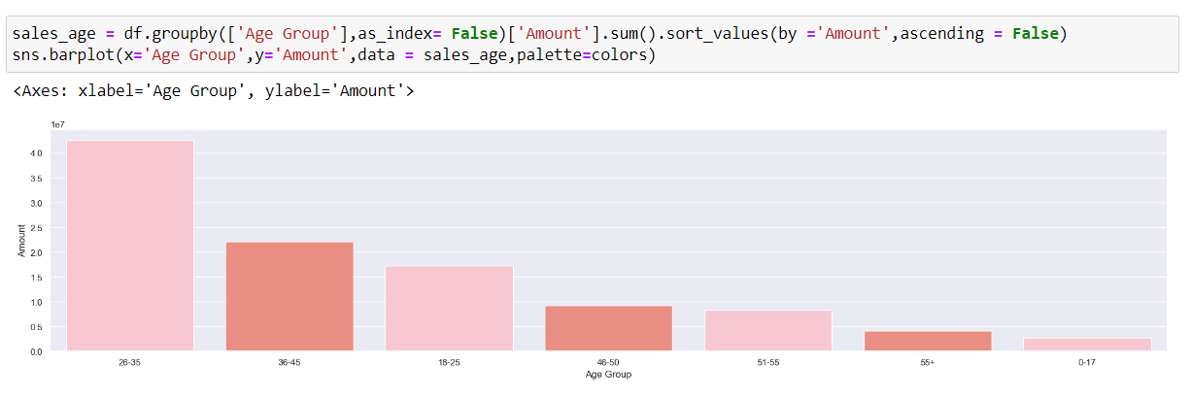
ON THE BASIS OF AGE
From the above graphs we can see that most of the buyers are of the age group between 26-35 years female

Slide 11
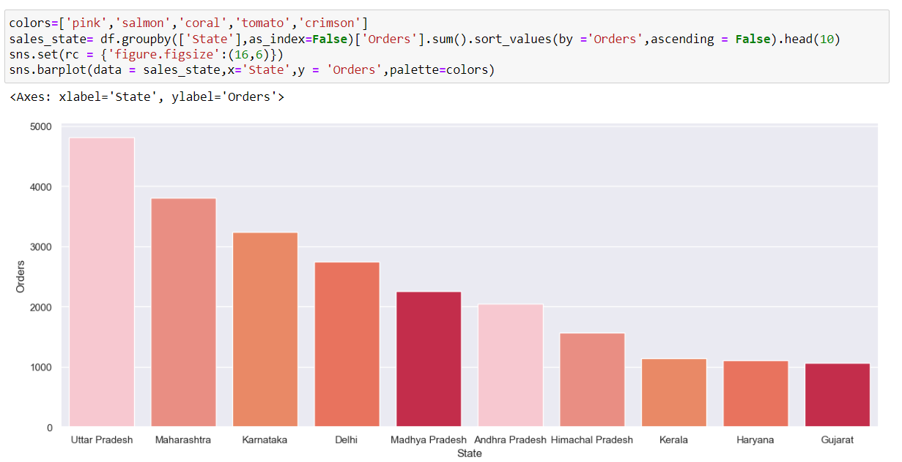
ON THE BASIS OF STATE
From the above graph we can see that most of the orders and total sales/amount are from Uttar Pradesh,Maharashtra and Karnataka

Slide 12
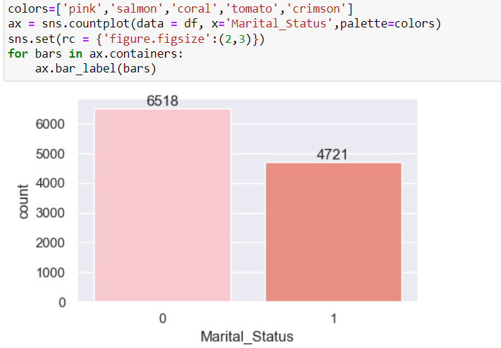
ON THE BASIS OF MARITAL STATUS
From the above graph we can see that most of the buyers are married and they have high purchasing power

Slide 13
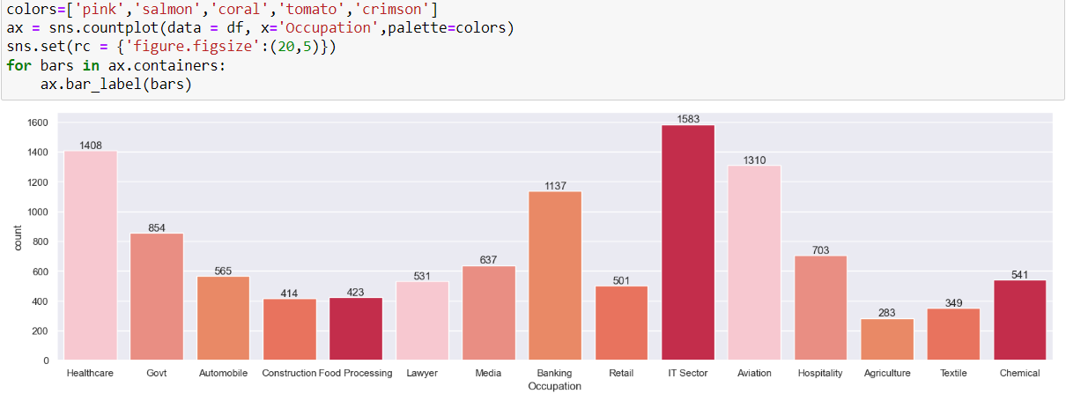
ON THE BASIS OF OCCUPATION
From the graph we can see that most of the buyers are working in IT,Healthcare and Aviation

Slide 14
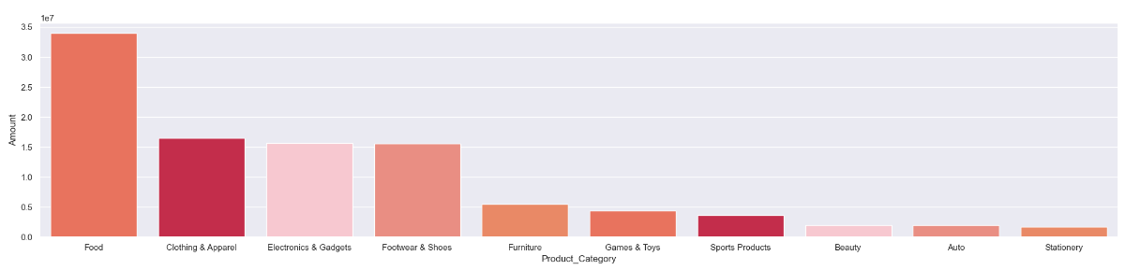
ON THE BASIS OF PRODUCT BOUGHT
From the above graph we can see that most of the sold products are from Food,Clothing and Electronics category with Food costs more than 30 million.

Slide 15
WHAT MORE CAN BE DONE?
Target campaigns specifically tailored for the 26-35 age group.
Implement seasonal offers to capitalize on festive and holiday periods.
Leverage influencer marketing to reach a broader audience.
Offer exclusive or limited-edition products to create urgency and exclusivity.
Implementing loyalty rewards programs and referral incentives, while sending personalized offers based on shopping behavior.
Encourage positive reviews and ratings to build trust and attract new customers.
Explore new geographical markets to expand customer base.
List products on popular online marketplaces to increase visibility and sales.

